Slide 1
Architecture Application
Project 2 - Eric Butler

Slide 2
Common Architecture Patterns
Architecture styles and patterns are sets of principles that shape an application. Some include:
Communication: Service Oriented Architecture (SOA), Message Bus
Deployment: Client/Server, N-Tier, 3-Tier
Domain: Domain Driven Design
Structure: Component-Based, Object-Oriented, Layered Architecture

Slide 3
Service Oriented Architecture pattern
Software Systems where components, called services, provide functionality to other components over a network. Elements include:
- Services: Self-contained unites of functionality.
- Loose Coupling: Services are independent and communicate through defined interfaces.
- Service Provider: Host services.
- Service Consumer: Utilizes services with knowing implementation.
- Service Interface: Operations a service offers
- Interoperability: Allows different systems to communicate together

Slide 4
Message Bus
Message bus serves as a communication infrastructure within a software system.
Allows components to communicate without direct dependencies.
Routes messages from producers to consumers based on rules.
Facilitates scalable architectures by handling message distribution efficiently.
Ensures reliable message delivery through built in systems like persistence.
Enables common communication platforms for systems.
Supports communication patterns that allow systems to operate independently.

Slide 5
Client / Server
Model in which computing tasks are divided between client machines and server machines.
- Client initiates requests for services or resources from the server.
- Server provides these requested resources.
- Clients are servers communicate over a network using protocols such as HTTP, TCP / IP.
- This type of architecture allows for scalability and flexibility tailored to a clients needs upon request.

Slide 6
N-Tier Architecture
N-Tier Architecture is a pattern where an application is divided up into multiple tiers / layers. Some of these include:
- Presentation Tier: Where the user interacts with things such as UI.
- Application Tier: The application logic responsible for processing the data.
- Data Tier: This is backend functionality for storing and receiving data (Data bases, file systems etc.)
- Scalability: Allowing for better performance management and resource allocation.
- Security: Separating tasks in order of sensitivity to allow for higher priority of important taks

Slide 7
Domain Driven Design
This is the design process of identifying what issue is occurring and solving the issues with the business and processes in mind.
This is also about creating a common language ground between both the technical team and the domain experts in order to have effective communication and all sides understand what is occurring.

Slide 8
Component Based Architecture
This is the architecture process of building a system or model using reusable parts. In the aspect of computer science, this is the process of building a system with reusable functions and logical components that will operate communication interfaces.
Some examples of functions could include setting attributes for a specific node e.g. Setting up functions to track a cars speed, length, location etc. And then calling that function when those attributes are needed.
This allows for breakdown of design into common functions as each function can be completed sepretly.

Slide 9
Object Orientated Architecture
This is the architecture design pattern in which every I/O, processing files, functions is represented as an object which allows for breakdown of code / processes in which objects are only called when required.

Slide 10
Layered Architecture
Similar to N-Tier Architecture, Layered Architecture separates an application into distinct layers each having it’s own purpose similar to those described in the N-Tier Architecture slide

Slide 11
Which would suit best for me?
I’ve chosen the component based architecture approach as I’ve been developing my project through different ‘components’ at a time. For example was my Mapping, Then my Network nodes and CAPL rules, moving towards my traffic light system.
All these components had multiple tasks that needed to be created within them such as:
- The traffic light system needing: Bitmaps created, CAPL code, Sys Variables
- Wrong direction needed: Mapping, Network Nodes, CAPL code, Sys Variables all separate to the traffic light.
* These components combine together to make my overall simulation design

Slide 12
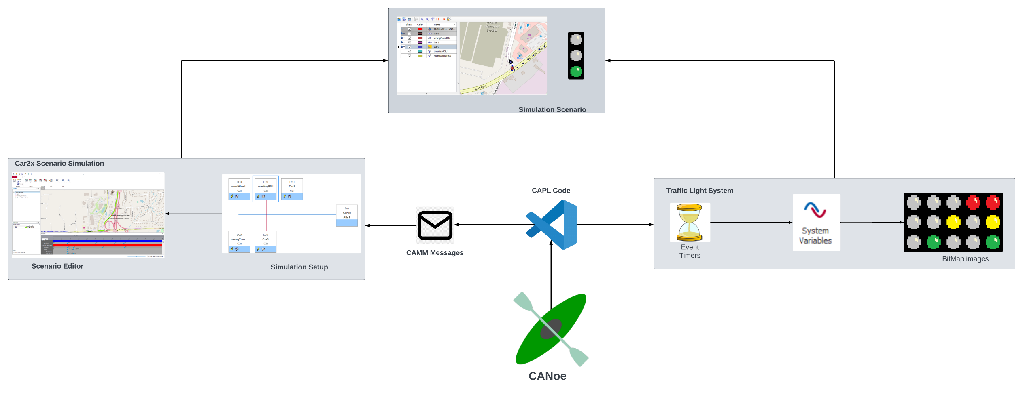
Attempt at Architecture Diagram

